Slide 1




Pollen Grain Classification

Slide 2

About: Microscopic Data
In the field of Ecology, years of research revolve around collection of a given specimen & all of its data.
The data in question must be properly cleaned, sorted, and stored.
After collecting a given specimen, it goes under a microscope, where the subject is magnified.
Staining techniques highlight features & dark/light field photography are needed to better view subject data
With this said, a lot of time and care goes into each step of the process.
Because of this, Microscopic datasets are much smaller, feature rich, and fragile.

Slide 3
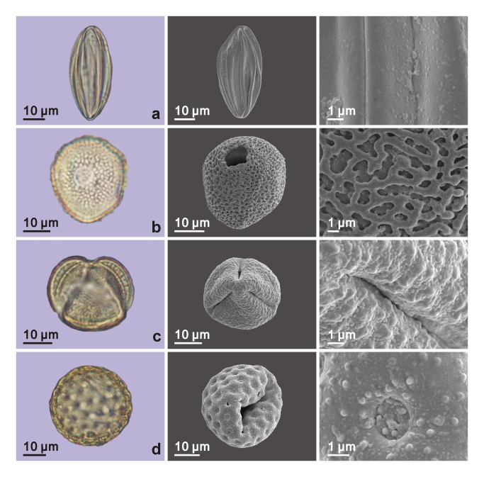
What is the Data?
Pollen remains difficult to identify traditionally, with avg. microscopy accuracy scores of 67%
Pollen grains come in a multitude of shapes/sizes individualized to a single plant
Pollen grains are on avg. Comparable to a speck of dust, making their study especially sensitive.

Slide 4
What is our goal?
Can deep learning improve upon a traditional accuracy of 67 percent?
Can our Pollen Dataset be properly identified with clean and dirty samples?
Can our trained model accurately predict dirty data it has never seen?

Slide 5

About the dataset
z
There are 5 families of Pollen in this dataset. for the families/species of Pollen and Lice. The total image count is 2273: 1034 for pollen and 1239 for lice.
Pollen images are taken using Light-Field Microscopy while Lice images use both light and dark-field microscopy.

Slide 6
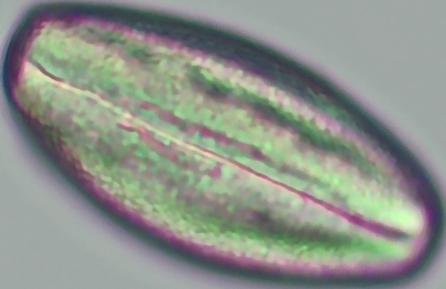
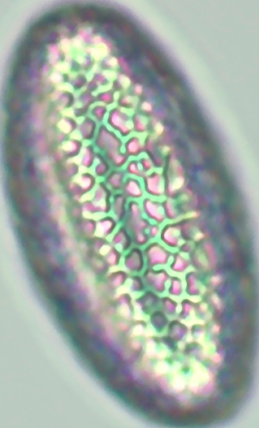
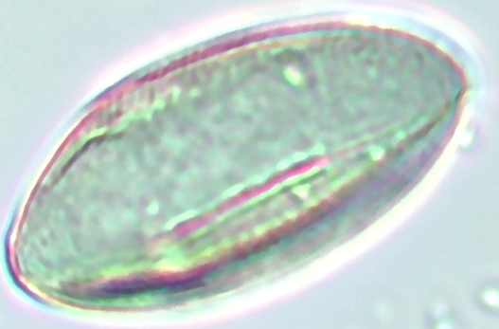
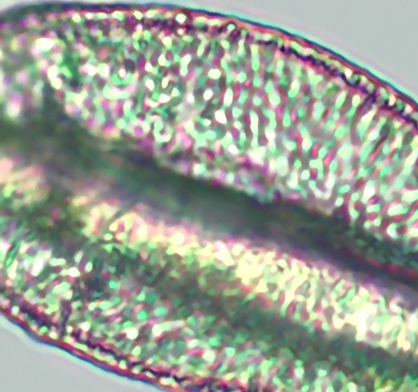
Pollen
z
Pollen images are a consistent resolution of 300x300 px.
The pollen images are centered and retain most visual fidelity while the edges may be blurry.
Most importantly, these samples are not dyed using artificial colors, unlike other studies

Slide 7
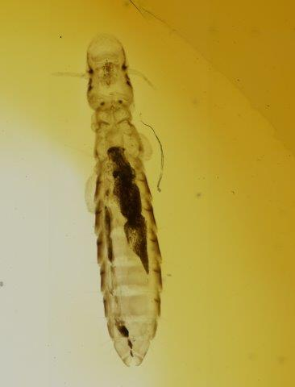
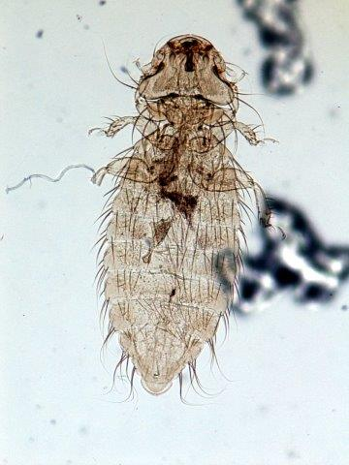
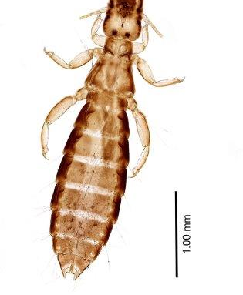
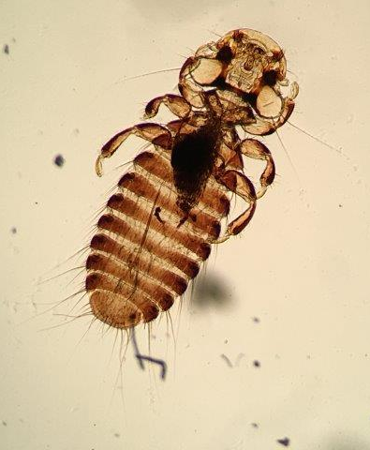
Lice
z
Lice images are all an inconsistent resolution,
Some photos are out of focus, have stains and other visible debris on the cell, or have other defects.

Slide 8
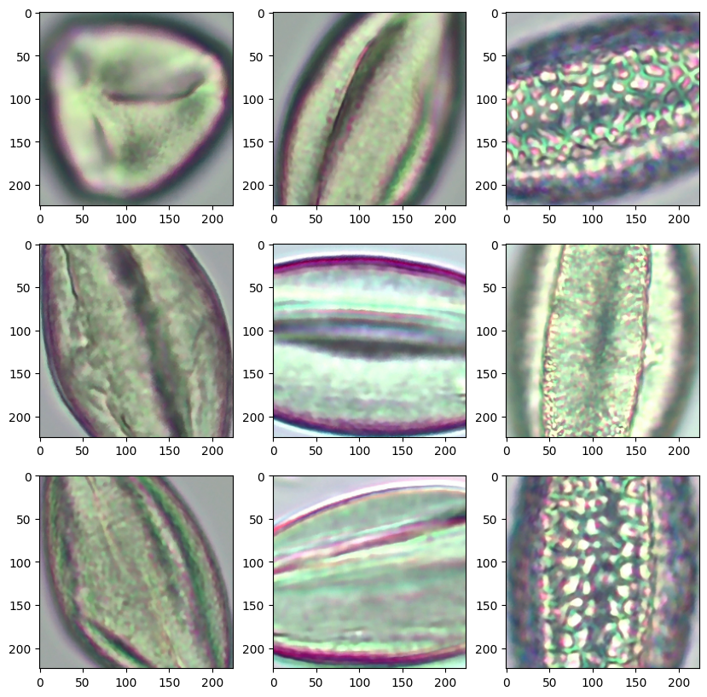
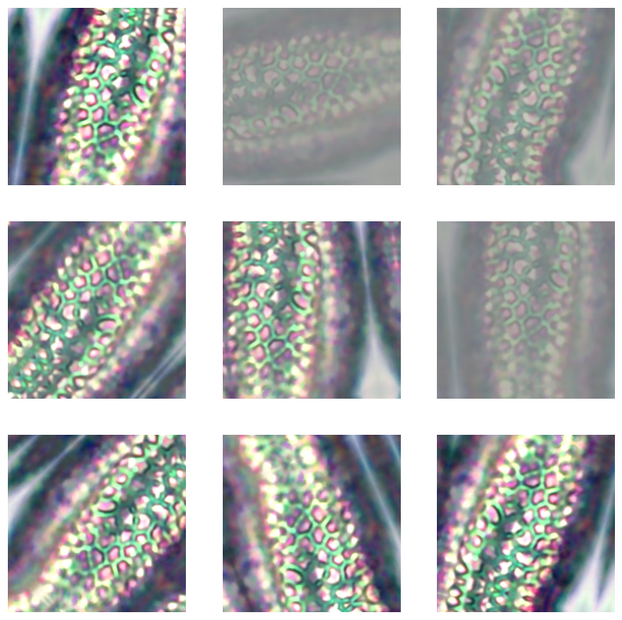
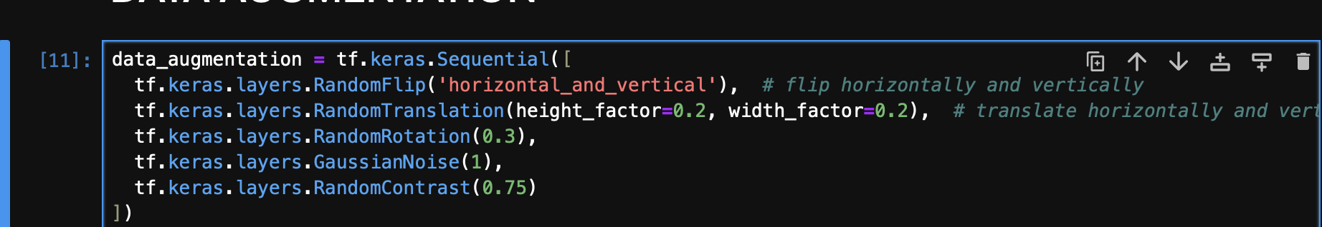
Preprocessing
Loaded the Pollen Images into a Tensorflow Dataset
80/20 Training/Validation (828/206)
Added Sequential Augmentation:

Slide 9
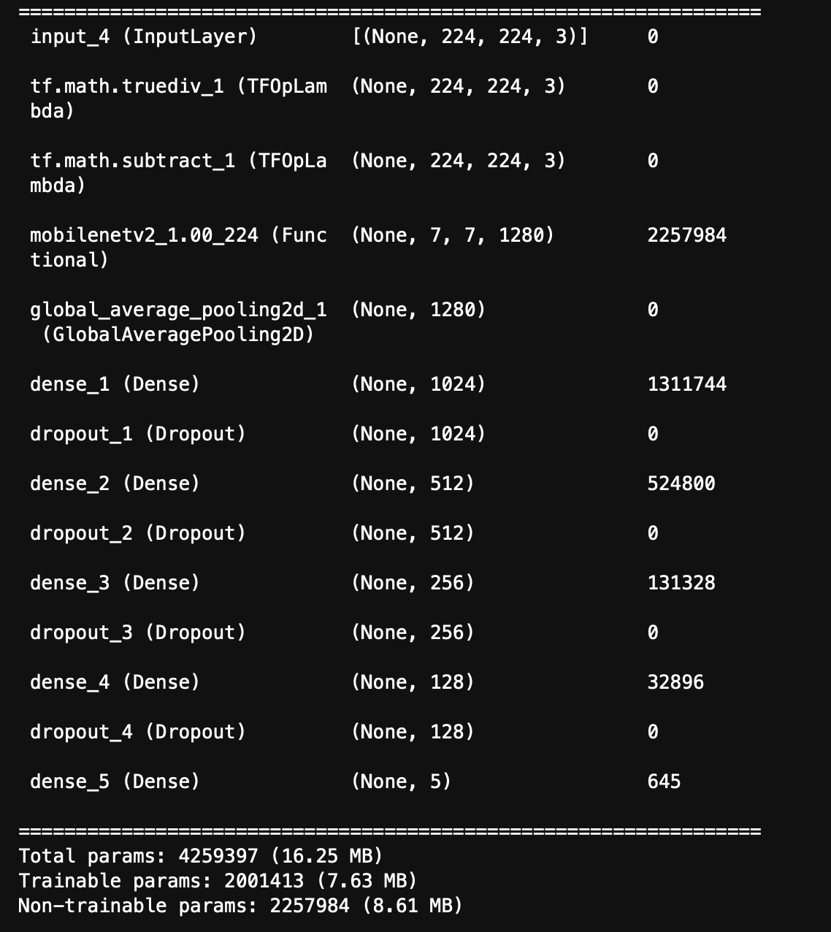
MobileNetV2
Layers:
Dropout at 50% each Layer for ReLu & the final layer softmax
Compilation:
Decay Rate 96% 100 steps
Batch Size 8
LR: .001
Adam Optimizer
Categorical Crossentropy Loss
50 Epochs
Early Stoppage @ 18 epochs

Slide 10
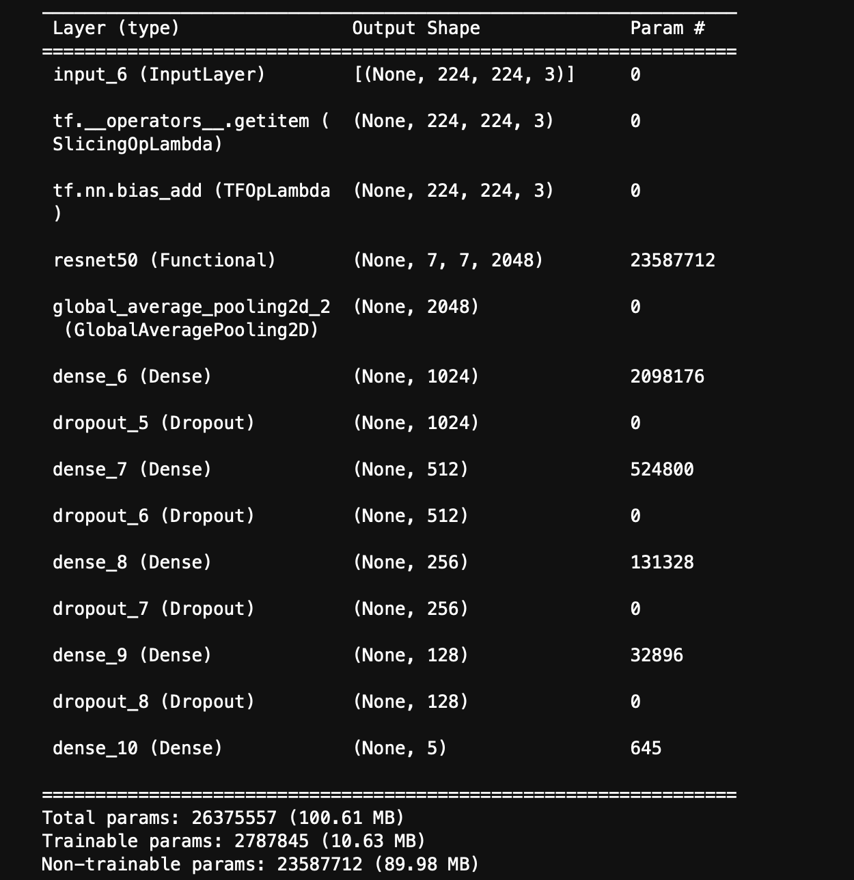
ResNet50
Layers:
Dropout at 50% each Layer for ReLu & the final layer softmax
Compilation:
Decay Rate 96% 100 steps
Batch Size 8
LR: .001
Adam Optimizer
Categorical Crossentropy Loss
50 Epochs
Early Stoppage @ 11 epochs

Slide 11
InceptionNetV3
Layers:
Dropout at 50% each Layer for ReLu & the final layer softmax
Compilation:
Decay Rate 96% 100 steps
Batch Size 8
LR: .001
Adam Optimizer
Categorical Crossentropy Loss
50 Epochs
Early Stoppage @ 11 epochs

Slide 12
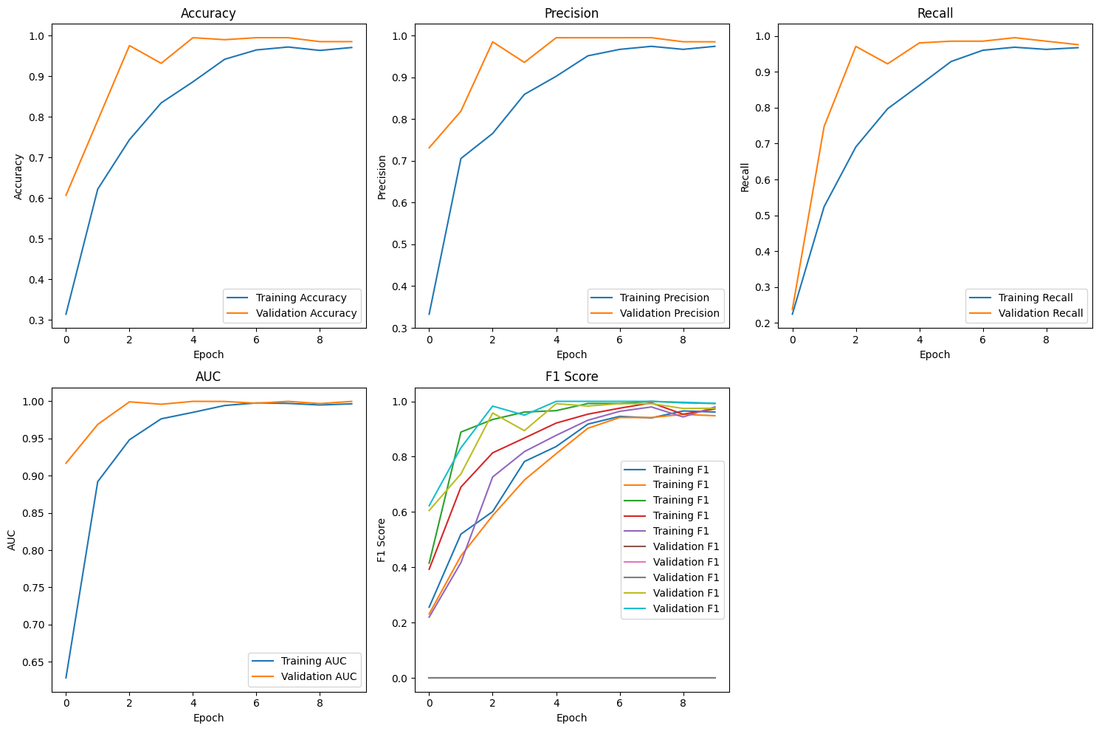
MobileNetV2 Results
Training | Loss: 0.0226 | Accuracy: 99.5% | Recall: 99.5% | Precision: 99.4% | F1: 99.5% | AUC: 99.9%
Validation | 0.0196 | 99.5% | 99.5% | 99.5% | 39.8% | 100%

Slide 13
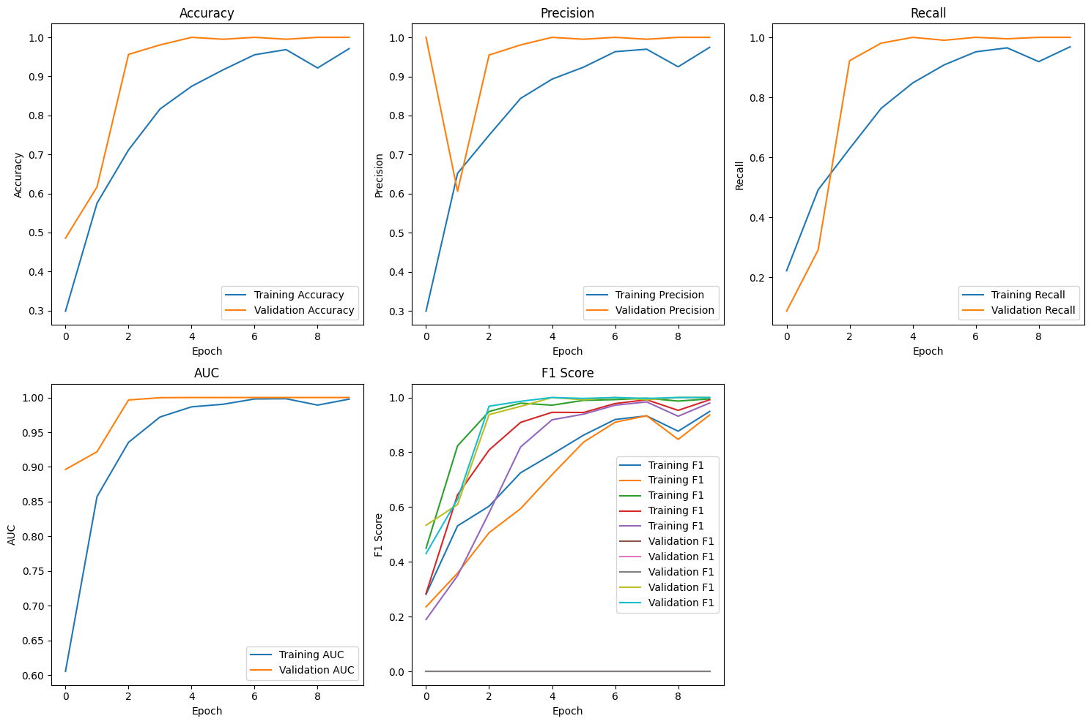
ResNet50 Results
Training | Loss: 0.0870 | Accuracy: 97.1% | Recall: 96.9% | Precision: 97.5% | F1: 97% | AUC: 99.8%
Validation | .0012 | 100% | 100% | 100% | 40% | 100%

Slide 14
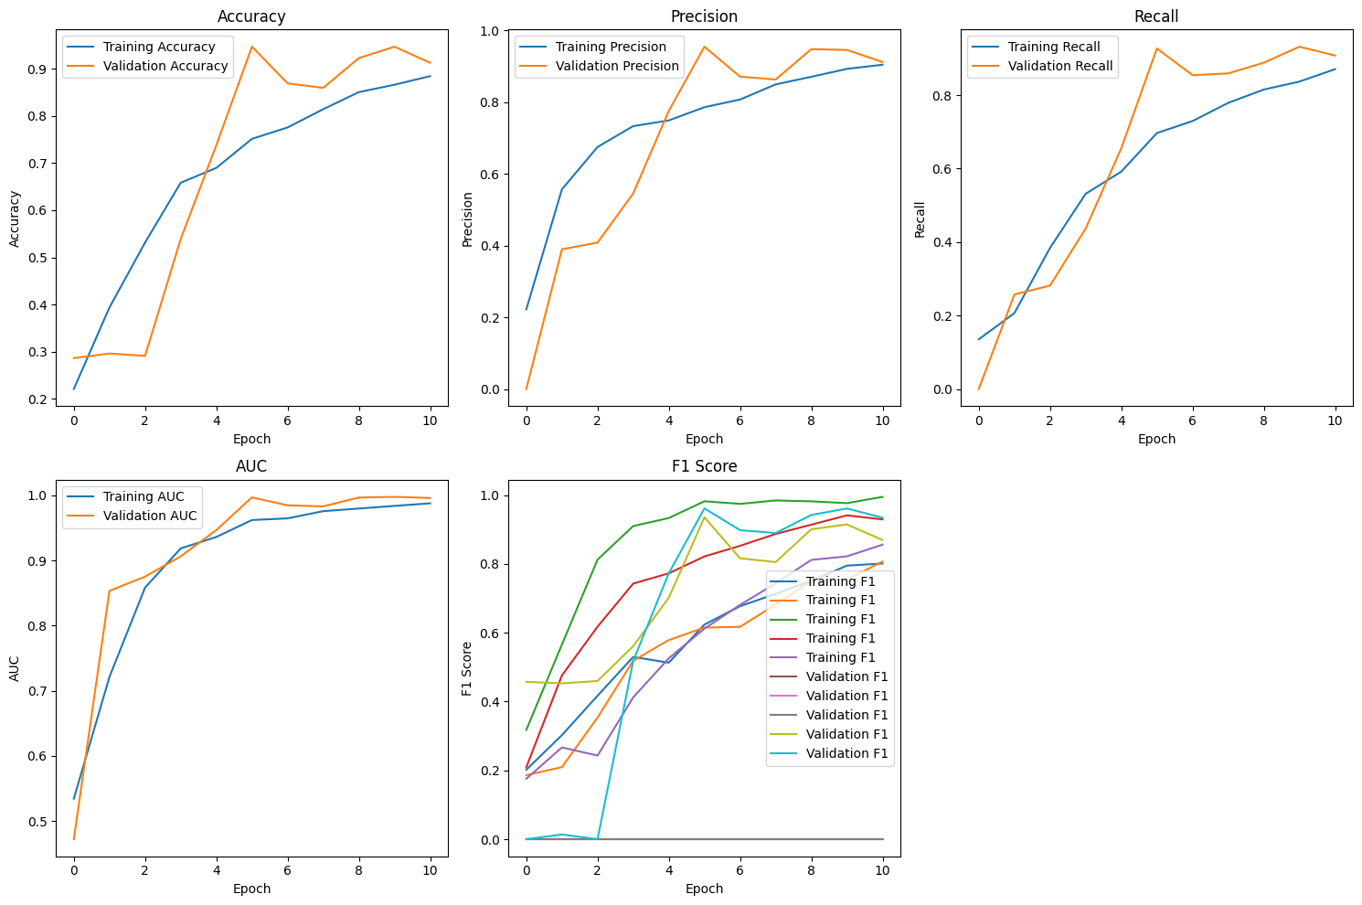
InceptionV3 Results
Training | Loss: 0.2921 | Accuracy: 88.4% | Recall: 87% | Precision: 90.4% | F1: 87.8% | AUC: 98.8%
Validation | .1733 | 91.2% | 90.8% | 91.2% | 36.1% | 99.6%

Slide 15
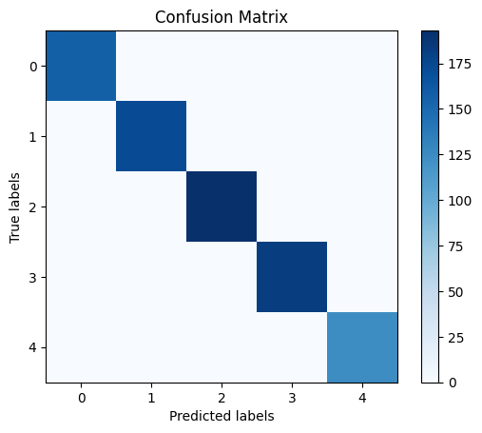
MobileNetv2 Conf. Matrix
z
Training:
0 Misclassifications

Slide 16
ResNet50 Conf. Matrix
z
Training:
0 Misclassifications

Slide 17
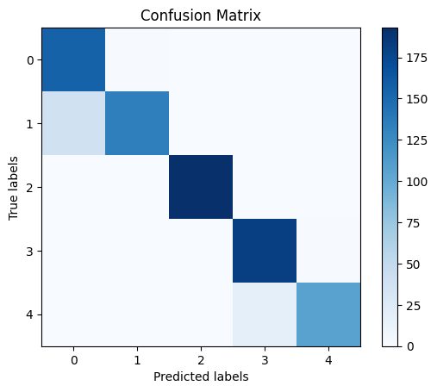
InceptionV3 Conf. Matrix
z
Training:
Class 1 is being misclassified as class 0 in 38 cases.
Class 3 is being misclassified as class 4 in 1 case.
Class 4 is being misclassified as class 3 in 17 cases
Could be due class similarity

Slide 18
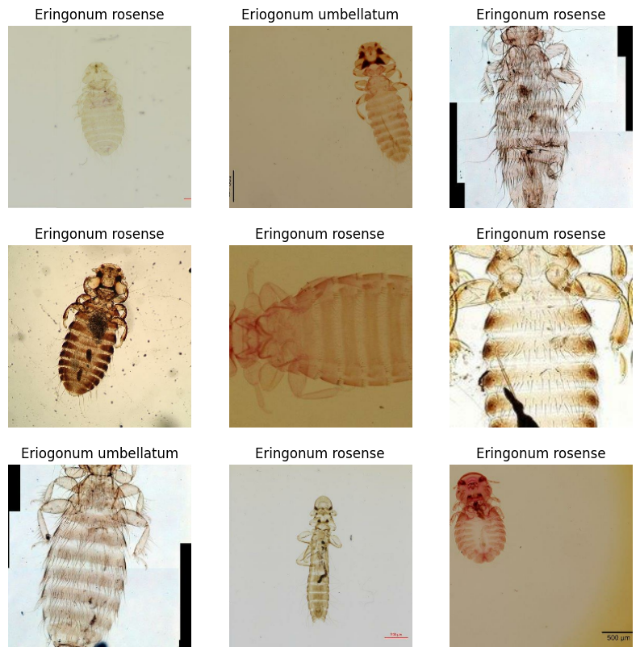
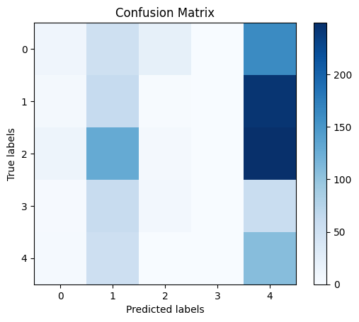
MobileNetv2 Model 2 on Lice
z
Test:
Heavy class imbalance bias towards Class 4 which has the largest data of the Lice Data

Slide 19
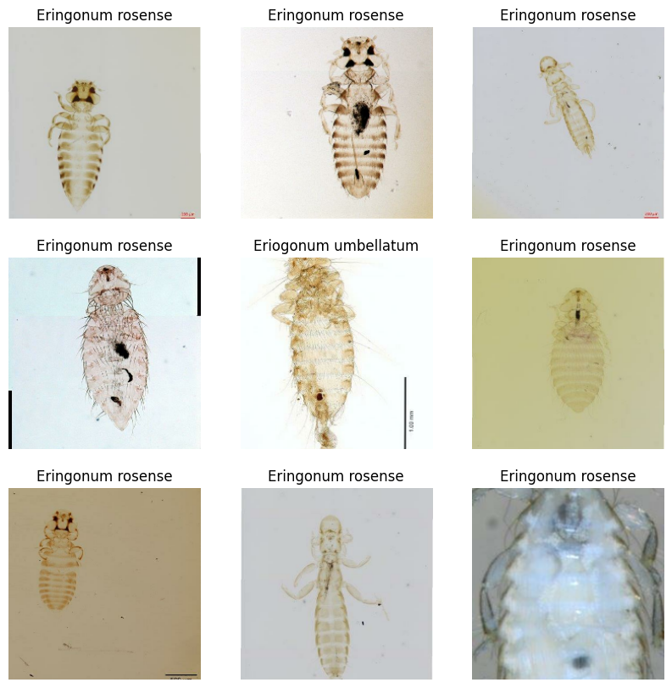
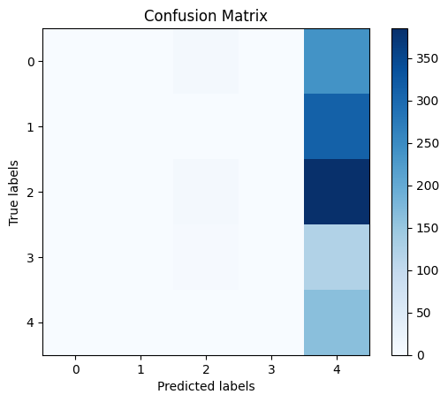
ResNet50 on lice
z
Prediction:
13% accuracy and a Loss of 10.308
Complete bias towards class 4

Slide 20
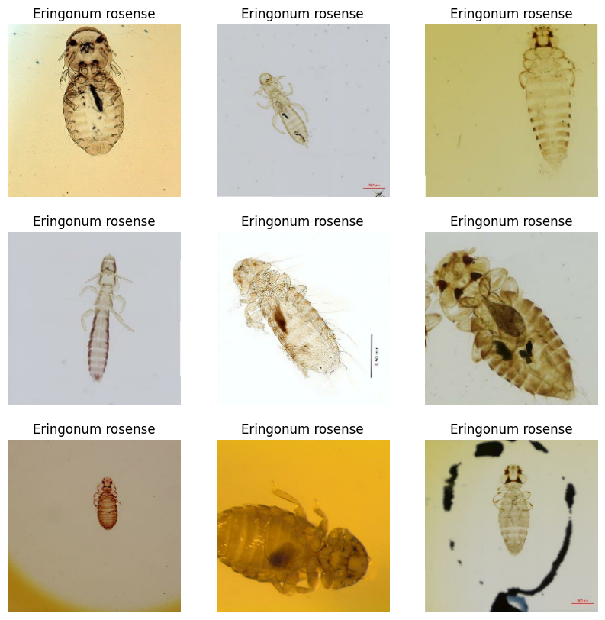
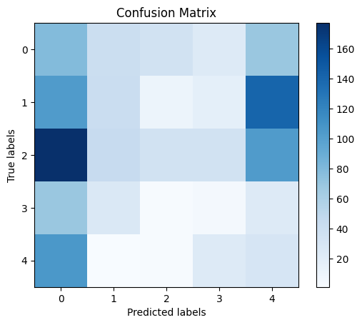
InceptionV3 Lice Dataset Predictions
z
Evaluation:
loss: 2.7125
accuracy: 15.1%

